Slide 1



Your Master Problem List
Working FOR you or AGAINST you?
Julie M. Green, DVM, MS
Veterinary Terminology Services Laboratory
August 28, 2016
Notes:
Look at structured recording of our Master Problem list….. How must of us are doing and How doing it well can facilitate benefits, not just for ourselves and our practices, but all of veterinary medicine.
Look at common problems with the lists in medical record systems today, and why moving towards the use of an external standard such as the AAHA Prob and Diagnosis Terms is the right thing to do.

Slide 2
“The Master Problem List”
The Master Problem List
The Diagnosis List
Differential Diagnosis List
“Things that are Wrong with our Patients”

Slide 3


What are you goals?
Capture Data
Retrieve My Own Cases
Share Records
Pool Data

Slide 4

Communication
Productivity
Entertainment
Banking
Travel
Education
Shopping
Our Health
Pet Health
Notes:
Cell phones and electronic devices organize our lives…carry all important data with us…
Clients are beginning to expect their pets’ data to be electronically portable…
Reality: Vet EMRs are not capable of truly portable data
Some services mine EMRs (Pattersons’ eHealth) and make patient data viewable online for owners, but this data is not transferrable to other clinics or systems.

Slide 5


Truly Portable Data
Messaging Standards
Terminology Standards
Shared Data Model
Notes:
Truly Portable Data requires:
Means: My data “fits” into your EMR... If I’ve coded diagnoses for a transferred patient, it comes up in searches within YOUR EMR for that patient (can’t do this with a pdf of a case summary)
Won’t go into the technical details, but Truly Portable Electronic data requires Share Data model, Terminology Standards and Messaging standards
Emailing a pdf of a patient summary is NOT portable data. You can store and read the file, but you can’t import the individual pieces of data (diagnoses, lab values, weights, etc) into your own system.

Slide 6
Truly Portable Data
Messaging Standards
Terminology Standards
Shared Data Model
Slightly less complex than data modeling
Nice, logical first step

Slide 7
A Place to Start….
The Master Problem List
Notes:
The Master Problem list serves as an important part of nearly all medical records giving a quick historical view of the patient’s medical history.

Slide 8
Standardization – The Local List
Everyone uses the same list
Any EMR will have this level of standardization
Benefits (vs free text recording):
  Internal consistency
  Prevent common spelling errors
  Promotes consistent & reliable retrieval
Problems:
  Incomplete
  Users will “change” the list, introducing inconsistency, misspellings, duplication
Notes:
PROS:
Internal consistency – problems in the problem list….not owner notes, demo info, procedures performed
Spelling…. How many ways can we spell diarrhea?
Retrieval: with standardization this list of possibilities is already present…cardiac failure vs heart failure, kidney vs renal,.... To retrieval all in free text storage, you have to first think of all the possibilities…..
CONS:

Slide 9
Standardization - The Local List
User – introduced problem #1: Duplication
Veterinarian with cardiologist interest diagnoses: Arrhythmogenic right ventricular cardiomyopathy
  Doesn’t find it in local list: Adds it manually
Another veterinarian diagnoses: Boxer cardiomyopathy
  Doesn’t find it in the local list….(forgets the more technically correct term): Adds it manually
Now we have 2 codes for the same disorder
Search for 1 misses the cases recorded with the other – INCOMPLETE RETRIEVAL
Notes:
Veterinarians and technicians don’t have the time or training to be “in house terminologists”

Slide 10
Standardization - The Local List
User – introduced problem #2: Ambiguity
Overworked veterinarian sees a congested kitten
  Searches for “congestion” & doesn’t find it quickly in local list: manually adds “Congestion”
Another busy veterinarian sees a dog with pulmonary congestion
  Searches for “congestion” & finds the one added above…records it in his record.
Now we have 1 code used for two different disorders
Search for “Congestion” returns a mixture of cases – LOSS OF DATA ACCURACY
Notes:
Veterinarians and technicians don’t have the time or training to be “in house terminologists”
Other examples: locations like “Fundus” (stomach or eye), “knee” (horse carpus or dog stifle)

Slide 11
Standardization - The Local List
User – introduced problem #3: Inconsistency
Mixture of “types” of codes get added:
  Procedures performed (spay, pedicure, AG)
  Notes on animal disposition (caution, will bite)
NOT “Master Problems” – belong elsewhere
Notes:
Veterinarians and technicians don’t have the time or training to be “in house terminologists”
Other examples: locations like “Fundus” (stomach or eye), “knee” (horse carpus or dog stifle)

Slide 12
Standardization – The Controlled List
“Controlled” list
  Managed using good principles of terminologies
    Maintain consistency
    Prevent misspellings
    Avoid duplication & ambiguity
Benefits:
  Internal consistency
  Prevent common spelling errors
  Promotes consistent & reliable retrieval
  Can’t be “dismantled” by users accidentally
Problems:
  Requires trained personnel
NOTE: Software must be “locked down” to prevent user changes

Slide 13
Standardization – The Controlled List
LOCALLY Controlled
Total control over wording
No reliance on External entity
Requires on-staff expertise
Codes will NOT transfer to other systems
VS
EXTERNALLY Controlled
Codes are TRULY PORTABLE
Highly trained external terminology expertise
Rely on External entity (submit requests!)
System needs capability of updating (vendor dependent)
Costs of maintenance

Slide 14
Truly Portable Data
=
External Standard
Recommended Standard (in US)
  SNOMED CT International (VetSCT)
    Adopted by US Public Health
    U.S. Meaningful Use Guidelines
    Only terminology standard that will keep Vet Med compatible with Public Health (and human medicine)
    Additional benefits:
      Logical structure for advanced querying
      Broad network of terminology experts developing and maintaining – high quality terminology

Slide 15
Truly Portable Data
=
External Standard
For Small Animal General Practice
  Problem & Diagnosis Terms (PDT Subset)
    Sponsored by AAHA
    Subset of concepts & descriptions from SNOMED & VetSCT
    Designed for recording problems or diagnoses
    Scope does NOT cover:
      Specialty practice
      Species other than cats & dogs
    Feedback so far is positive on coverage, though we expect expansion as more practices use it.

Slide 16
Truly Portable Data
=
External Standard
For Equine General Practice
  Problem & Diagnosis Terms (PDT Subset)
    Initially Sponsored by AAEP
    Subset of concepts & descriptions from SNOMED & VetSCT
    Designed for recording problems or diagnoses
    Scope does NOT cover:
      Specialty practice
      Species other than horses
    Being used at EMC (VaMdCVM)

Slide 17

AAHA Prob & Diag Terms
First Step …. Get the Terms in your system
Remove/inactivate current list
Add Prob & Diag Terms
If you’re lucky this is a simple request to your vendor (Cornerstone, Agile/cloud based systems, others??)
Prob & Diag Terms
PIMS Problem List

Slide 18
AAHA Prob & Diag Terms
Use Limited by what Current Systems can do
  Limitation #1: store only 1 term per identifier
    PDT Subset provides multiple terms for each concept
    Current systems force a single visible term
    Most use the “Preferred” term chosen by the PDT Editorial Board (specified in the files)
Example:
Concept ID: 281170005
Preferred Term: Boxer cardiomyopathy
Acceptable Term(s): Arrhythmogenic right ventricular cardiomyopathy
Notes:
We all have our own preferences…. (Boxer Cardiomyopathy v Arrhymogenic …)

Slide 19
AAHA Prob & Diag Terms
Use Limited by what Current Systems can do
  Limitation #2: size of identifier is limited
    SNOMED Identifiers are 64-bit integers
    Ex: Cornerstone altered the identifiers to fit their field
Example:
Concept ID: 334421000009101
Preferred Term: Feline leukemia virus infection
Cornerstone ID: 33442-101

Slide 20
AAHA Prob & Diag Terms
Use Limited by what Current Systems can do
  Limitation #3: update capability remains to be seen
    PDT Subsets are updated twice a year
    PIMS systems updated ???

Slide 21
AAHA Prob & Diag Terms
First Step …. Get the Terms in your system
No Batch import options (that I’m aware of)
Vendors may offer to load via support (Cornerstone)
Manual entry is most common (one code at a time)
Prob & Diag Terms

Slide 22
AAHA Prob & Diag Terms
First Step …. Get the Terms in your system
Prob & Diag Terms
Actual First Step …. Consider Legacy Data

Slide 23
AAHA Prob & Diag Terms
Legacy Data
Data already stored in your system using your current EMR’s list.

Slide 24
AAHA Prob & Diag Terms
Legacy Data
  Never recorded diagnosis/problems before?
    Whoo Hoo! You have no legacy data!
    Inactive existing codes….add PDT terms/codes…and you’re ready to go!
  Already been recording diagnosis/problems?
    Sorry…You have more work to do…

Slide 25
AAHA Prob & Diag Terms
Legacy Data – the simple way
  Just inactivate old code & add new ones
    Cornerstone “migration” does this
  No connection between old and new

Slide 26
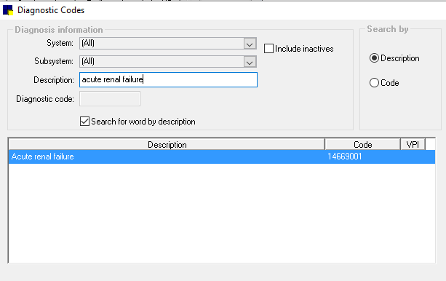
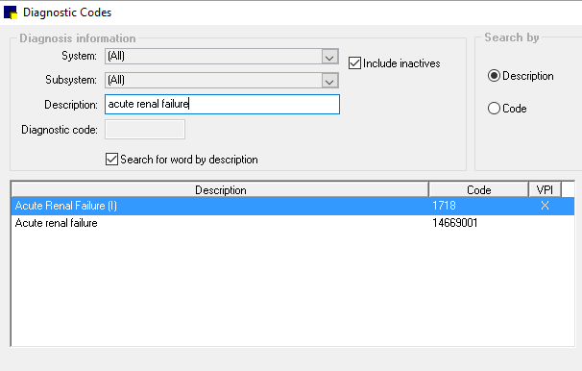
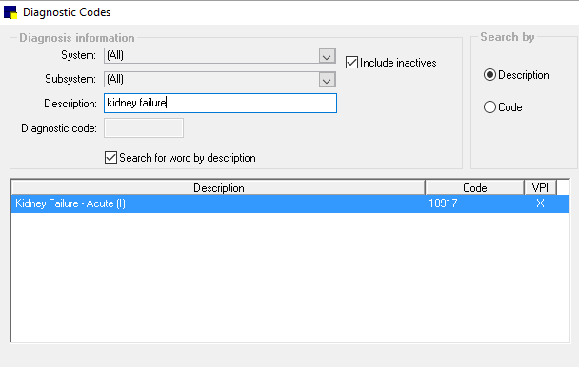
AAHA Prob & Diag Terms
Legacy Data – the simple way

Slide 27
AAHA Prob & Diag Terms
Legacy Data – the better way
  Create a “mapping”
    Compares existing terminology to AAHA (or AAEP) PDT
    Best done by terminologist or someone trained
Compare Existing with PDT concepts
Match Found?
yes
Add to
Mapping File
no
Needed?
no
Inactivate
yes
Submit
Request

Slide 28
AAHA Prob & Diag Terms
Legacy Data – the better way
  Create a “mapping”
    Compares existing terminology to AAHA (or AAEP) DT
    Best done by terminologist or someone trained
Kidney Failure – Acute (18917)
Match Found?
yes
Add to
Mapping File
Example Mapping File
PIMS | PDT | Exact?
18917 (Kidney Failure – Acute) | 14669001 (Acute Renal Failure) | YES
Inactivate

Slide 29
AAHA Prob & Diag Terms
Legacy Data – the better way
  Create a “mapping”
    Compares existing terminology to AAHA (or AAEP) DT
    Best done by terminologist or someone trained
Acute Renal Failure
(1718)
Match Found?
yes
Add to
Mapping File
Example Mapping File
PIMS | PDT | Exact?
18917 (Kidney Failure – Acute) | 14669001 (Acute Renal Failure) | YES
1718 (Acute Renal Failure) | 14669001 (Acute Renal Failure) | YES
Inactivate

Slide 30
AAHA Prob & Diag Terms
Legacy Data – the better way
  Create a “mapping”
  Add AAHA (or AAEP) PDT concepts
    Manual process
    Results will be combination of AAHA PDT and a few remaining existing terms, but no duplication

Slide 31
AAHA Prob & Diag Terms
Legacy Data – the better way
  Create a “mapping”
  Add AAHA (or AAEP) DT concepts
  Review old cases for updating
    Labor intensive, but only way to ensure old cases are retrievable/encoded
    Use the mapping file
      If case is coded with a term that has a match, consider updating diagnosis/problem coding with new PDT concept

Slide 32
AAHA Prob & Diag Terms
Biannual Updates
  April and October of each year
  Updates include
    New concepts
      to add to interface lists
    New synonyms for existing concepts
      Consider changing term in interface list if preferred
    Some concepts will be retired (replaced by new concepts)
      Inactivate in interface & consider reviewing records for update
  Vendor automated? Maybe? Hopefully????

Slide 33


Standardized data
True data portability
Out-of-box…no work for me…
The perfect PIMS

Slide 34


Thank you!
Contact Info:
Julie M. Green, DVM, MS
jmgreen@vt.edu
http://vtsl.vetmed.vt.edu
Questions?

